Slide 1
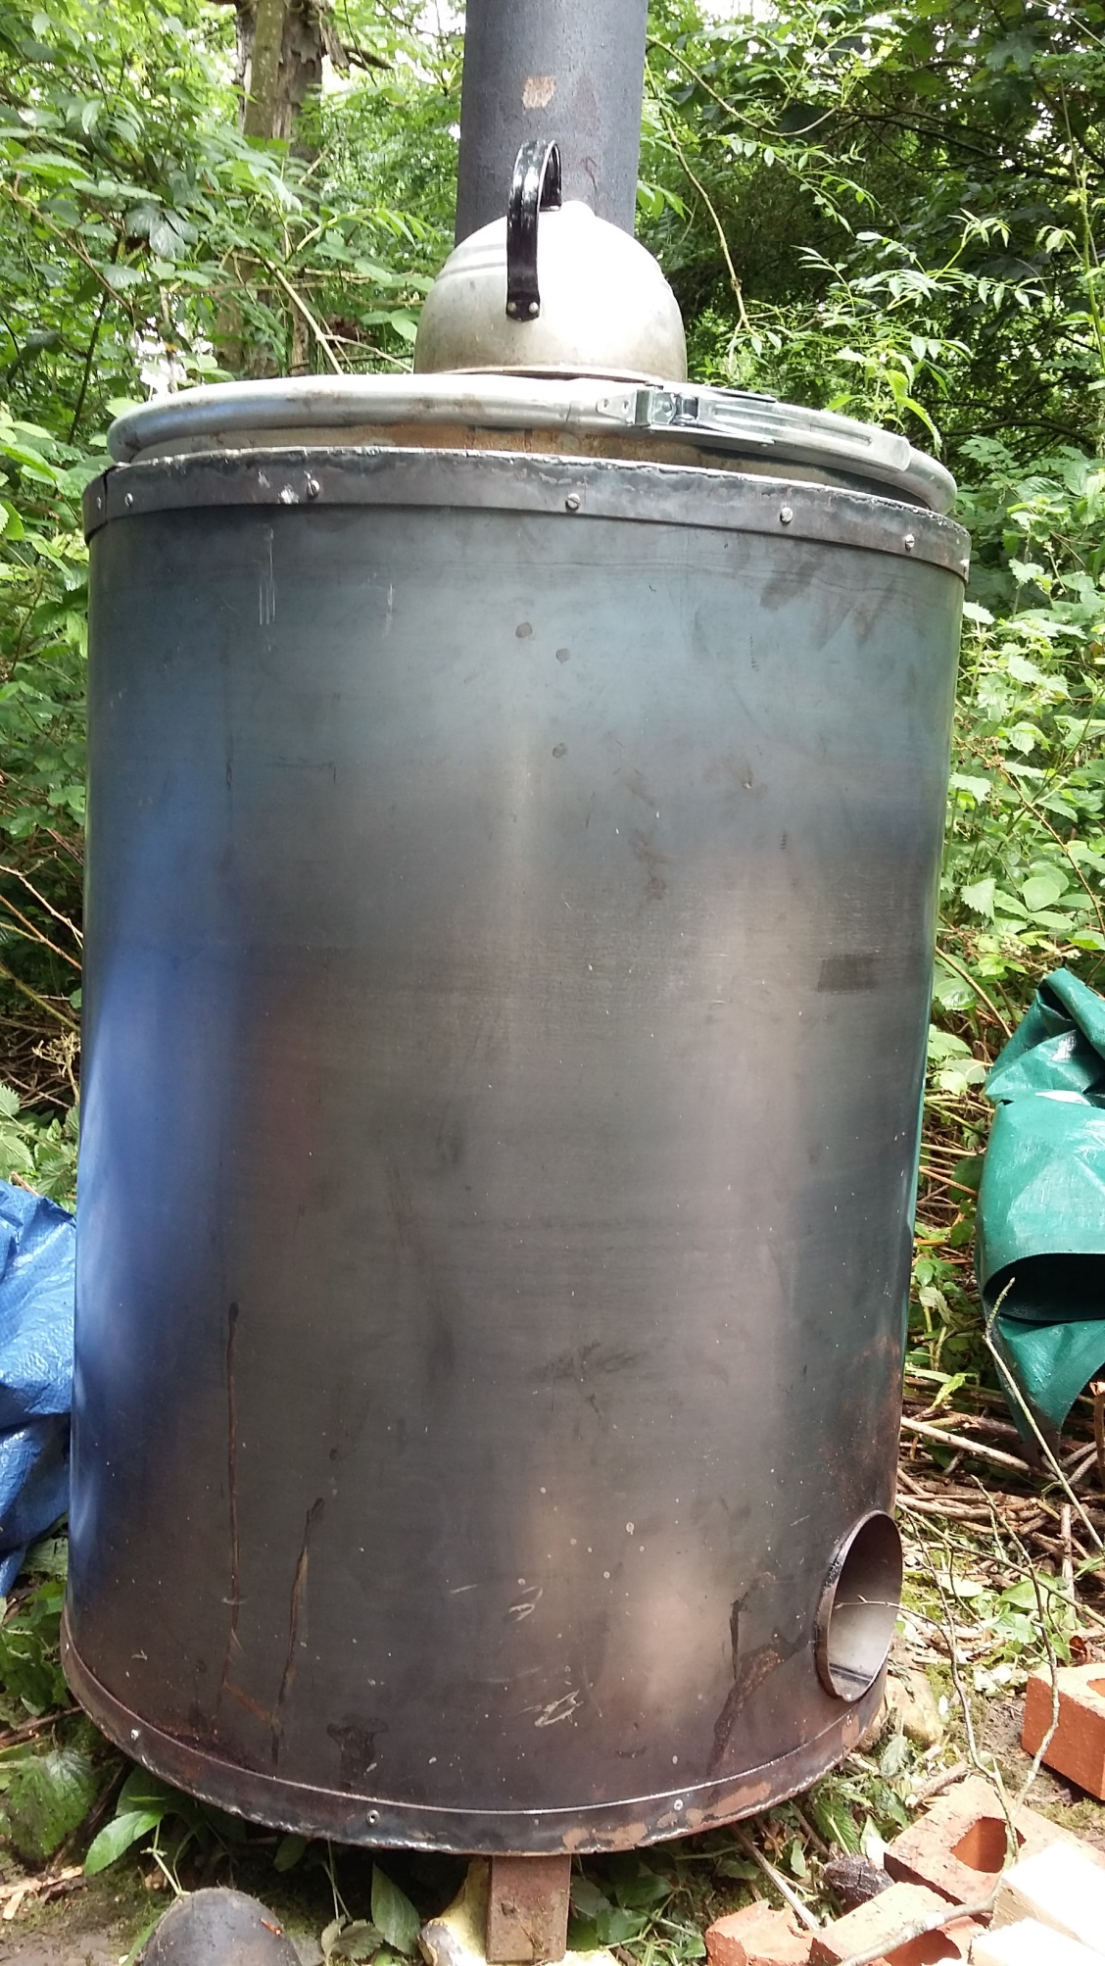
An animation of the retort

Slide 2
Cross section of the retort
Main chimney
Smaller exhaust tube
Fire chamber

Slide 3
Phase 1
Retort loaded with split logs

Slide 4

Phase 1
Fire lit

Slide 5
Retort starts to heat up

Slide 6
Water is driven off the
wood in the retort in the
form of steam…..
…..which then makes its way
down the exhaust tube

Slide 7
Gases then start to be driven
off the wood in the retort……

Slide 8
Gases start to be driven
off the wood in the retort….
….and these pass down the exhaust
into the combustion chamber

Slide 9
The wood gases ignite in the
combustion chamber……

Slide 10

The wood gases ignite in the
combustion chamber …..
and roar away

